Slide 1


Slide 2

Welcome to Chapter 3!
Foundations of Adult Education and Digital Learning

Slide 3
Session Objectives
Describe the five key theories of adult learning
Identify strategies for applying the theories of adult learning in the classroom and in program administration
Explore digital tools that can support effective adult learning experiences
Develop (or evolve) a plan for applying the theories of adult learning in their teaching practice and/or as part of their role as support staff
Notes:
🕧 = 1 minute
Introduce the objectives for today’s session, which are to understand adult learning theories and explore ways we can use digital tools to create meaningful learning experiences aligned with those theories.

Slide 4





Session Agenda
Reflect on digital learning experiences
Explore the theories of adult learning
Build a micro-lesson aligned with the theories of adult learning
Discuss implementation of adult learning theories
Explore next steps
Notes:
🕧 = 1 minute
Today’s agenda includes opportunities to explore ideas, to share ideas with our peers/colleagues, and to spend time applying key theories of adult learning into our classrooms and programs.

Slide 5
Warm-Up
What quadrant are you in today?
Energetic
2
1
Negative
Positive
3
4
Tired
Notes:
🕧 = 3 minutes
The goal of this activity is to provide a community-driven opportunity to ease into the session. It also showcases ways to use digital tools to create conversations between students, especially in a setting where there isn’t a single “correct” answer but rather many interesting ways to answer the same question (i.e. we are modeling effective use of digital tools to nurture conversation and collective problem solving)
Ask participants which quadrant they are in
Allow participants to share responses.
If being conducted online, you can highlight interesting responses in the chat
If being conducted in-person, you can reiterate and summarize what people are saying as a way to affirm their participation
👩‍🏫 Instructional strategy modeling: This showcases that there is not a right or wrong answer to the question (as is the case with most AE content). The learning happens through collaboration and the opportunity to explore how peers / fellow students are thinking through a similar problem.
💻 Digital connection. This activity can be facilitated on Zoom, with participants replying via chat with their quadrant (i.e., “I” and “IV”). If in-person, participants can respond out-loud. In either in-person or online settings, you could also place this on a Jamboard or Google Slides file and give participants an opportunity to respond with a marker or sticker. That could help to visualize responses in an interesting and engaging way while also modeling the use of digital tools. But, since there are several other digital tasks included in the session, it’s not essential to use digital tools here as this can be a quick activity that just gets people talking!

Slide 6

Quick Brainstorm
Think-Pair-Share
What’s been your best digital learning experience?
  What elements contributed to the positive experience?
What’s been your worst digital learning experience?
  What elements do you think contributed to that experience?
Notes:
🕧 = 10 minutes
To start today’s session, we’ll be exploring a topic with our neighbors.
Turn to a person next to you and explore the following two questions. As you talk, take note of interesting responses that you can share with the full group.
When thinking about “digital” learning experiences, this could be fully online or blended
When we finish talking to our neighbors, any group can share a few themes or interesting ideas that surfaced during the conversation.
If conducting the training online, present each question one at a time and allow participants to respond via chat.
As a facilitator, you should note/highlight interesting responses via chat.
Be careful to not suggest which responses are “right” or “wrong”, but instead, emphasize interesting responses with phrases like:
“Oh, that’s an interesting perspective, what do you all think?”
“I’ve never thought about it like that. Have any of you experienced something similar”?
As participants are discussing, provide supportive questions like: “What elements do you think contributed to the positive experience?”
💻 Digital connection. Consider using Padlet, Jamboard, Slido, or PollEverywhere to model their use and also create a repository of ideas that educators can continue to reference during and after the session.
Ask for pairs to share highlights of their conversation. The goal here is simply to lay a foundation for thinking critically about what elements of a course experience can lead to accessible and engaging learning experiences. Later in the session, we will use these conversations to think critically about the digital learning experiences we are developing for adult students.
👩‍🏫 Instructional strategy modeling: This showcases that there is not a right or wrong answer to the question (as is the case with most AE content). The learning happens through collaboration and the opportunity to explore how peers / fellow students are thinking through a similar problem. In these moments, your role as an instructor is not to define which answers are correct, but rather to showcase interesting responses, and nurture shared conversation between participants.

Slide 7

Theories of Adult Learning
Andragogy
Experiential Learning Model
Heutagogy
Self-Directed Learning
Transformative Learning
Each theory represents an opportunity to emphasize learner involvement, experience-based learning, autonomy, and perspective-changing experiences.
Notes:
🕧 = 3 minutes
Introduce the 5 key theories of adult learning as presented in Chapter 3
This portion of the activity is lecture style, but consider opening with a brainstorming questions, asking participants to share their understanding or examples of any of the concepts on screen. Then connect those responses to the following definitions:
Andragogy: Adults need to understand the purpose, content, and process of learning, and they are self-directed, drawing on their experiences and seeking practical, problem-centered learning opportunities.
Experiential Learning Model: Learning is a cycle that involves concrete experiences, reflection, abstract conceptualization, and active experimentation, allowing learners to engage with and apply new knowledge.
Heutagogy: Learners take ownership of their learning, deciding what and how to learn, and engage in self-reflection and double-loop learning to continually adapt and grow.
Self-Directed Learning: Adult learners vary in their preferences for self-directed learning, and educators must understand their individual needs, providing guidance and support as learners progress through stages of dependence, interest, involvement, and self-direction.
Transformative Learning: Learning aims to challenge and transform learners' assumptions and perspectives, encouraging dialogue, reflection, and the development of inclusive and open-minded habits of mind.

Slide 8
Example #1: Theories of Adult Learning
What this can look like
Transformative learning: In a social studies class, students are able to rethink and evolve their perspective after participating in moderated online forums where they engage in debates with peers from various backgrounds. Data visualizations, fact-checking tools, and real-time polling help students gain a deeper understanding of complex issues.
How the use of digital tools aligns with adult learning theories
Technology-facilitated dialogue and exposure to diverse perspectives in an online political debate forum catalyze a shift in a student's previously perspective, fostering open-mindedness and nuanced understanding of complex issues.
Notes:
🕧 = 2 minutes
Here’s an example of an adult learning theory in practice.
The top-level bullet shows the example, and the sub-bullet articulates how technology is used to nurture effective learning experiences
Transformative learning can be accomplished in a social studies class where students can use a digital tools to expand perspectives, learn from peers with diverse backgrounds, and use data to inform the conversation.

Slide 9

Example #2: Theories of Adult Learning
What this can look like
Self-directed learning: An English language learner uses an app like Duolingo to set personal goals, practice daily, and engage in bite-sized, game-like lessons tailored to their proficiency level.
How the strategy aligns with adult learning theories
Enables students to take ownership of their learning paths
Notes:
🕧 = 2 minutes
Here’s another example of an adult learning theory in practice.
The top-level bullet shows the example, and the sub-bullet articulates how technology is used to nurture effective learning experiences
Self-Directed Learning: In a self-directed learning environment, the instructor designs a blended learning course where learners have access to various resources, such as online modules, interactive activities, and discussion forums. Adult learners can choose the pace, content, and learning modalities that best suit their needs and preferences. The instructor provides personalized guidance and check-ins, adapting the course to accommodate diverse learning styles and interests.
As an example, an English language learner uses an app like Duolingo to set personal goals, practice daily, and engage in bite-sized, game-like lessons tailored to their proficiency level. The Duolingo content can supplement their other coursework.
After both examples, pause to ask the group of any examples they’ve built or experienced that showcase adult learning theories like:
Andragogy
Experiential Learning Model
Heutagogy
⭐ Self-Directed Learning. This may be the easiest topic for participants to share an example of, so consider focusing the conversation here. “In what ways have you seen digital tools help to nurture effective self-directed learning, either in your own classroom or in courses you’ve taken.”
Transformative Learning

Slide 10
Applying Theories of Adult Learning
What can this look like?
Andragogy - How can you address the learners' need to know?
Experiential Learning Model - What experience can learners draw upon or engage with?
Heutagogy - How can you incorporate learner autonomy?
Self-Directed Learning - What choices can you give learners in their education process?
Transformative Learning - How can you challenge learners to reflect and change their perspectives?
Activity: Choose one and design a 15-minute micro-lesson that exemplifies it.
Notes:
🕧 = 15 minutes
This activity is designed to help participants begin applying key theories into their own programs and classrooms.
Divide participants into small groups and assign each group a theory of adult learning
Ask each group to brainstorm strategies for applying their assigned theory in the classroom. What could this strategy look like if implemented effectively in a micro-lesson?
The micro lesson should be something that takes adult students 15 minutes or less to complete. This is just a sample lesson that gives us a chance to practice exploring what it look like to implement these ideas in our classrooms.
🗣️ Facilitation tip: Encourage groups to start the conversation by identifying a note-taker and presenter so it’s clear to group members who will be capturing ideas and who will be responsible for presenting conversation highlights to the full group.
🗣️ Facilitation tip: Frame the activity with a clear deliverable. For example, groups should come prepared to share at least one practical lesson idea for how they can apply the theory. So as they brainstorm several ideas, and as groups are talking, gently remind them to focus their energy on choosing their favorite or the most useful strategy that arises during the brainstorming.
📄 Digital Learning Guidance connection: Direct everyone to page 45 of the DLG to find more complete definitions and examples of each theory. (https://otan.us/media/tysjmzko/ca_adult-learning-guide_081822-a11y.pdf)
🗣️Facilitation tip: You can also offering guiding questions for each item:
When you consider Andragogy, think about how you can communicate the importance of the lesson and why it's relevant to your learners.
If you choose Experiential Learning, your lesson should include an activity or discussion that allows learners to draw on their own experiences or engage in a new experience related to the topic.
For Heutagogy, your lesson design should consider how learners can take control of their learning, perhaps through choice in tasks or a self-evaluation component.
If you opt for Self-Directed Learning, you'll want to think about ways to empower learners to set their own goals and make decisions about how they learn.
And if you decide on Transformative Learning, try to incorporate opportunities for learners to critically reflect and potentially change their perspectives or beliefs.
💻 Digital connection: Instead of prescribing a specific goal or learning artifact as the outcome for professional learning, consider introducing tools like Google Docs and Microsoft PowerPoint so educators have more creative control in how they design and deliver their learning artifacts. In this kind of PD, your role may no longer be to set goals and deliver content but rather coach, motivate, and facilitate learning as educators build new skills and work towards their self-defined goals. Then, each group can share their discussion in any way they choose.
🗣️Facilitation tip: If you’d prefer to provide more structure, consider using a Google Slides or Microsoft PowerPoint slide deck where each group can capture and present their micro-lesson. Before the session, create a slide for each theory, then provide a quick tour of the deck before the conversation begins so participants can see how and where they are able to take notes and present key insights from the activity.
As groups present, you can project the slide deck for everyone to see as a supportive visual to guide the report from each group.

Slide 11
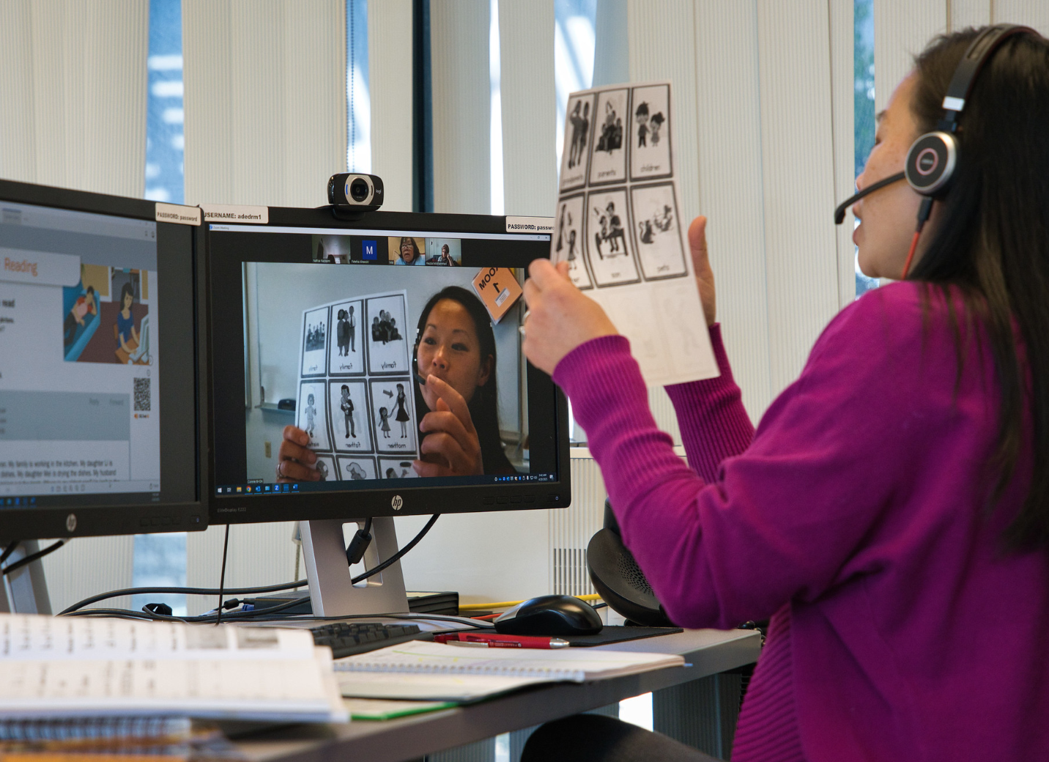
Sharing Micro-Lessons
Sharing our micro-lessons
Share your micro-lesson with a peer / group
Take turns presenting your micro-lesson, including a short explanation of how adult learning theories have been applied
Use “I notice” and “I wonder” statements to provide feedback
  Examples on next slide
Notes:
🕧 = 10 minutes
Peer feedback and reflection
Divide participants into small groups of 3-4 people.
Instruct participants to share their designed activity with their group members, either by sharing their screen or providing access to their digital activity.
Each participant should take turns presenting their activity to the group, explaining how they applied the theories of adult learning.
Encourage participants to ask questions and engage in a constructive discussion about each activity.
🗣️ Factiliation tip: Provide examples of “I notice” and “I wonder” statements to guide the feedback process (examples on slide 13)

Slide 12
Sample Feedback
“I notice…”
"I notice that you incorporated interactive elements in your activity, such as quizzes and polls, to engage learners and encourage active participation."
"I notice that you designed an activity that encourages learners to collaborate and discuss their perspectives, promoting a sense of community and shared learning."
“I wonder…”
"I wonder if there could be additional opportunities for learners to provide feedback or interact with each other during the activity."
"I wonder if there could be alternative ways for learners to engage with the content, such as through multimedia elements or interactive simulations."
Notes:
🕧 = 10 minutes
Examples of feedback
Provide examples of the kinds of feedback that participants can offer each other on their lessons.
This is also an opportunity to reinforce key adult learning theories that are reflected in the sample statements (i.e. “I notice that you designed the activity in a way that encourages learners to collaborate and discuss their perspectives, promoting a sense of community and shared learning."
🗣️ Facilitation tip: Keep this slide open and visible during the group conversation so participants can reference these ideas in support of the conversation as they provide feedback on micro-lessons from their peers.
🗣️ Facilitation tip: As participants talk, remind the group that the purpose of the conversation is not to identify a “right” or “wrong” answer, but rather to learn from the constructive feedback as the group collectively works to identity how to bring adult learning theories to life through digital learning experiences.
Consider modeling some of the potential feedback types:
"I notice that you incorporated interactive elements in your activity, such as quizzes and polls, to engage learners and encourage their active participation."
"I notice that you provided clear instructions and guidelines for learners to follow, which helps promote a sense of autonomy and self-direction."
"I notice that you included opportunities for learners to reflect on their prior experiences and connect them to the new content, which aligns well with the theories of andragogy."
"I notice that you designed the activity in a way that encourages learners to collaborate and discuss their perspectives, promoting a sense of community and shared learning."
"I wonder how learners will have an opportunity to apply the knowledge gained from this activity in a real-world context?"
"I wonder if there could be additional opportunities for learners to provide feedback or interact with each other during the activity."
"I wonder if there could be alternative ways for learners to engage with the content, such as through multimedia elements or interactive simulations."
"I wonder how learners will be able to reflect on their learning and measure their progress after completing this activity."

Slide 13

What’s Next?
Chapter 3 of the Digital Learning Guidance provides more details and discussion of key theories
The self-paced course on the OTAN website includes a multiple choice quiz and extension activities
Continue finding opportunities to learn from each other as we explore best practices in digital age adult learning
Notes:
🕧 = 5 minutes
Provide a brief summary of today’s session and Chapter 3 in general
Understanding the Theories of Adult Learning:
Recap the theories of adult learning discussed in the session (andragogy, experiential learning, heutagogy, self-directed learning, and transformative learning)
Emphasize the importance of recognizing adult learners' autonomy, prior experiences, and the practical application of knowledge.
Highlight how these theories create a learner-centered approach that engages adults in active participation, reflection, and the application of new knowledge in real-world contexts.
Empowering Adult Educators:
Acknowledge the essential role adult educators play in creating meaningful and effective learning experiences for adult learners.
Inspire educators to embrace these theories as tools to empower learners, foster a positive and inclusive learning environment, and support learners' autonomy and self-direction.
Continual Exploration and Growth:
Encourage adult educators to view the theories of adult learning as a starting point for their professional growth and development.
Urge educators to continue exploring research, best practices, and innovative approaches in adult education to refine their instructional strategies and adapt to the evolving needs of adult learners.
Highlight the potential impact of applying these theories, such as fostering transformative learning experiences that empower learners to become lifelong, self-directed learners.

